Slide 1

The Pathway to Licensing Patents
A Step-by-Step Overview of Agreements
Emily W. Loughran
July 19, 2023

Slide 2
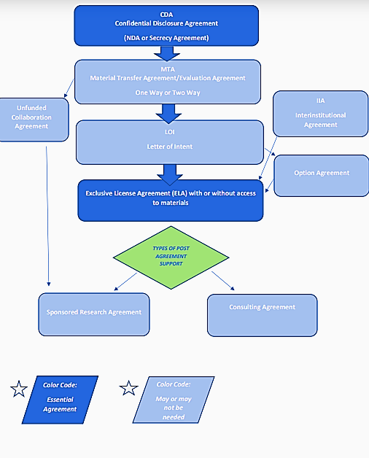
Continuum of Agreements along the Pathway to Licensing

Slide 3
Step 1: NDA (Nondisclosure Agreement)/CDA (Confidential Disclosure Agreement)
Key Considerations:
Need for NDA/CDA protection?
  Are all patents under discussion for licensing issued?
  Are there unpublished/unissued and pending patents?
  Are there improvements underway that may not yet be protected?
Is NDA One-way or Mutual?
  Is there going to be a two-way collaboration and need for access to licensee confidential information?
  Is there a risk/liability to licensor associated with exposure to licensee potentially competing confidential information.

Slide 4
CDA/NDA Cont.
Term of CDA
  Length of Agreement typically a year or length of negotiation.
  Obligation to hold information in confidence survives the term and typically runs 3-5 years from date of disclosure to other party.
  Governing Law
    Request governing law of your own country or state. Accepting Governing Law of the other party can make any future disputes costly and complex to resolve.
    When unable to agree, stay silent.
    Same advice for venue of dispute resolutions.

Slide 5
Step 2: Material Transfer Agreement (MTA)
Key Terms of MTA/Evaluation Agreement for Materials Associated with Patents
Scope of Work
  Provide precise description of work to be conducted with materials as well as strict limitations on sharing materials with third parties or use in humans.
Ownership of Materials
  Retain ownership of materials and restrict all uses outside of Scope.
Term of Agreement
  Require return or destruction of materials at end of term
  Include confidentiality provisions around disclosure of proprietary details regarding material
Indemnification
  Require indemnification by recipient.

Slide 6
Step 3: Letter of Intent (LOI)
Advantages of Entering LOI During License Negotiations
  LOI simple to execute with minimal legal expense/effort
  License negotiations may be lengthy
  LOI may provide patent owner with reimbursement of ongoing patent expenses during license negotiations
  LOI may allow, depending upon stage of patent prosecution, the potential licensee to provide input and reimbursement for election of foreign territories at National Stage.
  LOI separates the serious licensees from the casually interested parties.
  If license negotiations are protracted, a formal option may be put in place.

Slide 7
Step 3.5: Exclusive Option Agreement
If License negotiations take longer than the term of an LOI, an Option Agreement is an appropriate next step.
Benefits of an Option Agreement:
Optionee may make progress towards commercialization under the option agreement so that development time is not lost during license negotiation. Patent term is valuable.
Parties able to lock in financial terms of license under the option and focus on non-financial components of the license.

Slide 8
LOI vs Option
LOI
Option
Exclusive Right to Negotiate a License, no rights to use patents.
Short Term (3-6 months)
Upfront fee
No License Terms Incorporated
Ongoing patent reimbursement
No use of patents therefore no insurance required.
Right to use patents for internal evaluation and planning but no commercial sales.
Longer Term (1-2 years)
Upfront fee, renewal fee
High Level License Terms
Diligence requirements for any renewal of term
Commercial Insurance required

Slide 9
Step 4: License Agreement
Key Terms
Exclusivity (Exclusive or Nonexclusive)
Field of Use
Geographic Territory
Right to Sublicense (percentage of sublicensing income)
Milestone Payments for reaching developmental and commercial milestones
Royalty Rate on Sales of Licensed Product/Minimum Annual Royalties
Diligence Timeline for Commercialization of Licensed Product

Slide 10
Thank You
Questions?
Emilywloughran@gmail.com

